Slide 1
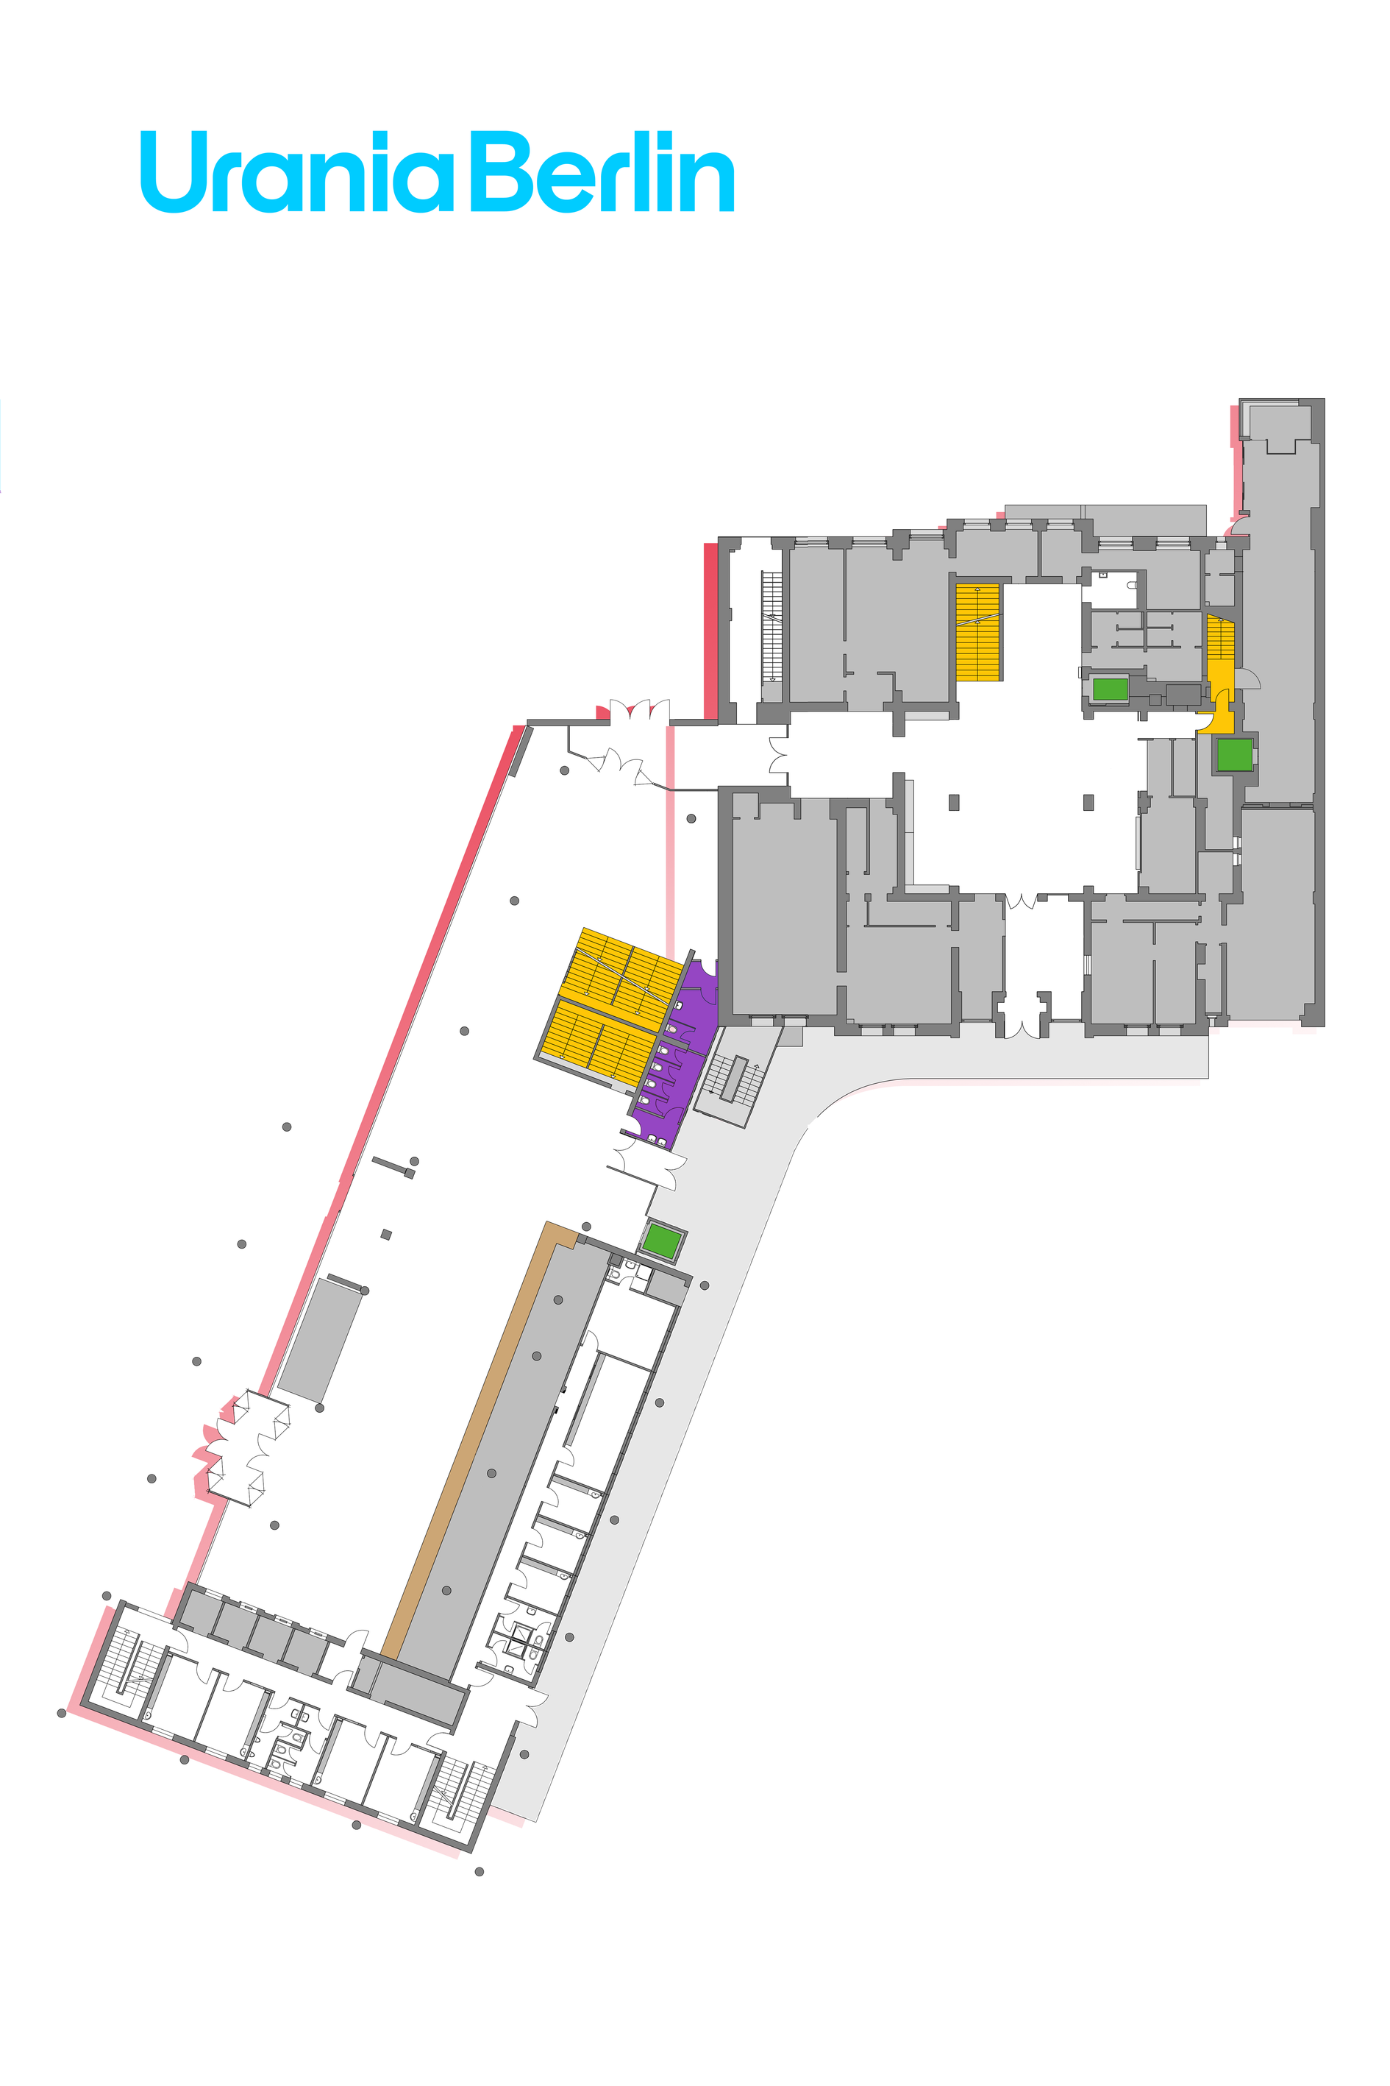


Urania Berlin
Ground Floor
To floor 1
1,2,3
Tesla Foyer
Networking
Organisations Fair
Catering
Arnheim-Foyer
To floor 1
⚡Charging Station⚡
Point D4
Courtyard
Point D3
Tesla Foyer
Outside Area 1:1s
Point D2
Arnheim Foyer
1
Main entrance
An der Urania 17
Point D1
Walking 1:1s
Registration / Info Desk - - Wardrobe
Prayer Room Parents Room
Nap Rooms
Meeting point
Elevators
Stairs
Gender-neutral bathrooms Stages

Slide 2
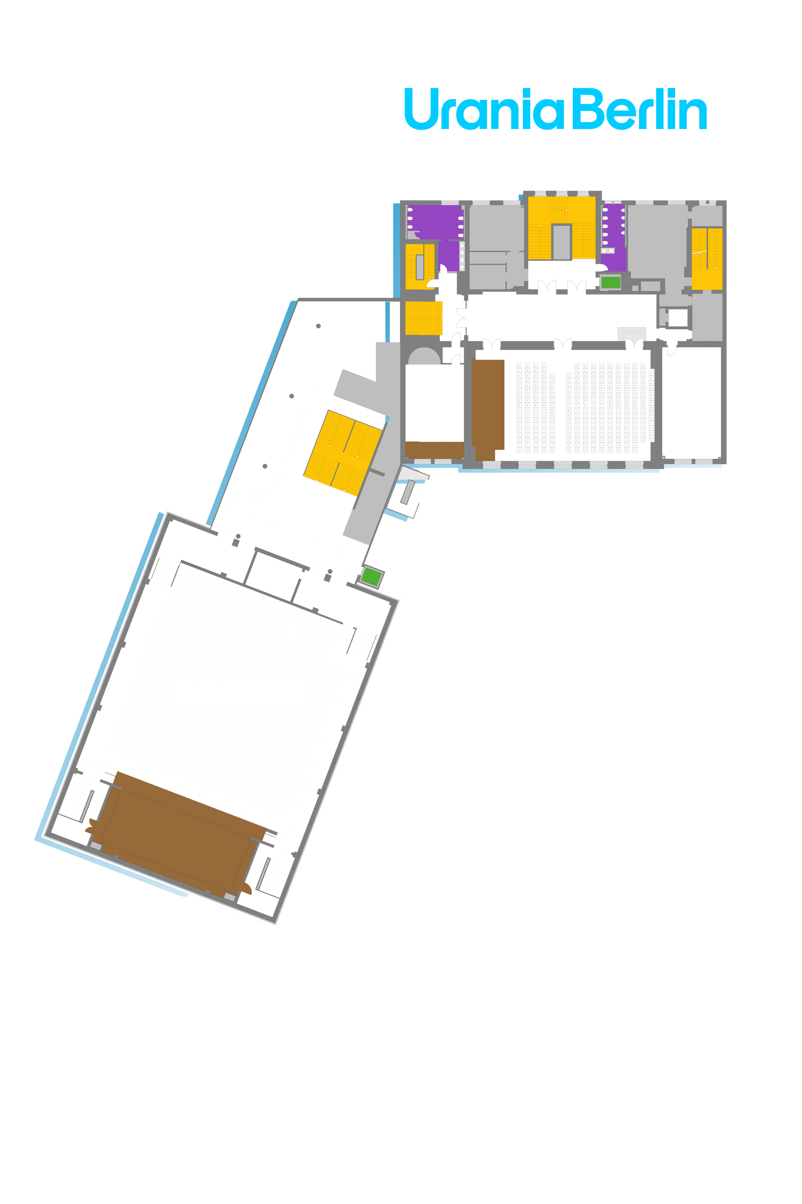
Urania Berlin
First Floor
Point C5
Kleist Staircase
Point C3
Cafeteria
to floor 0
0,2,3
2,3
First Floor Foyer
Catering
Einstein
Meet-Ups
Kleist Hall
Talks
Kepler
Volunteer Room
Cafeteria
Point C4
Kleist Hall
To floor 1
Point C6
Einstein
Project fair
0
Humboldt Hall
1:1s, Movie Screening
Point C2
Humboldt Hall Right
Point C1
Humboldt Hall Left
Meeting point
Elevators
Stairs
Gender-neutral bathrooms Stages

Slide 3
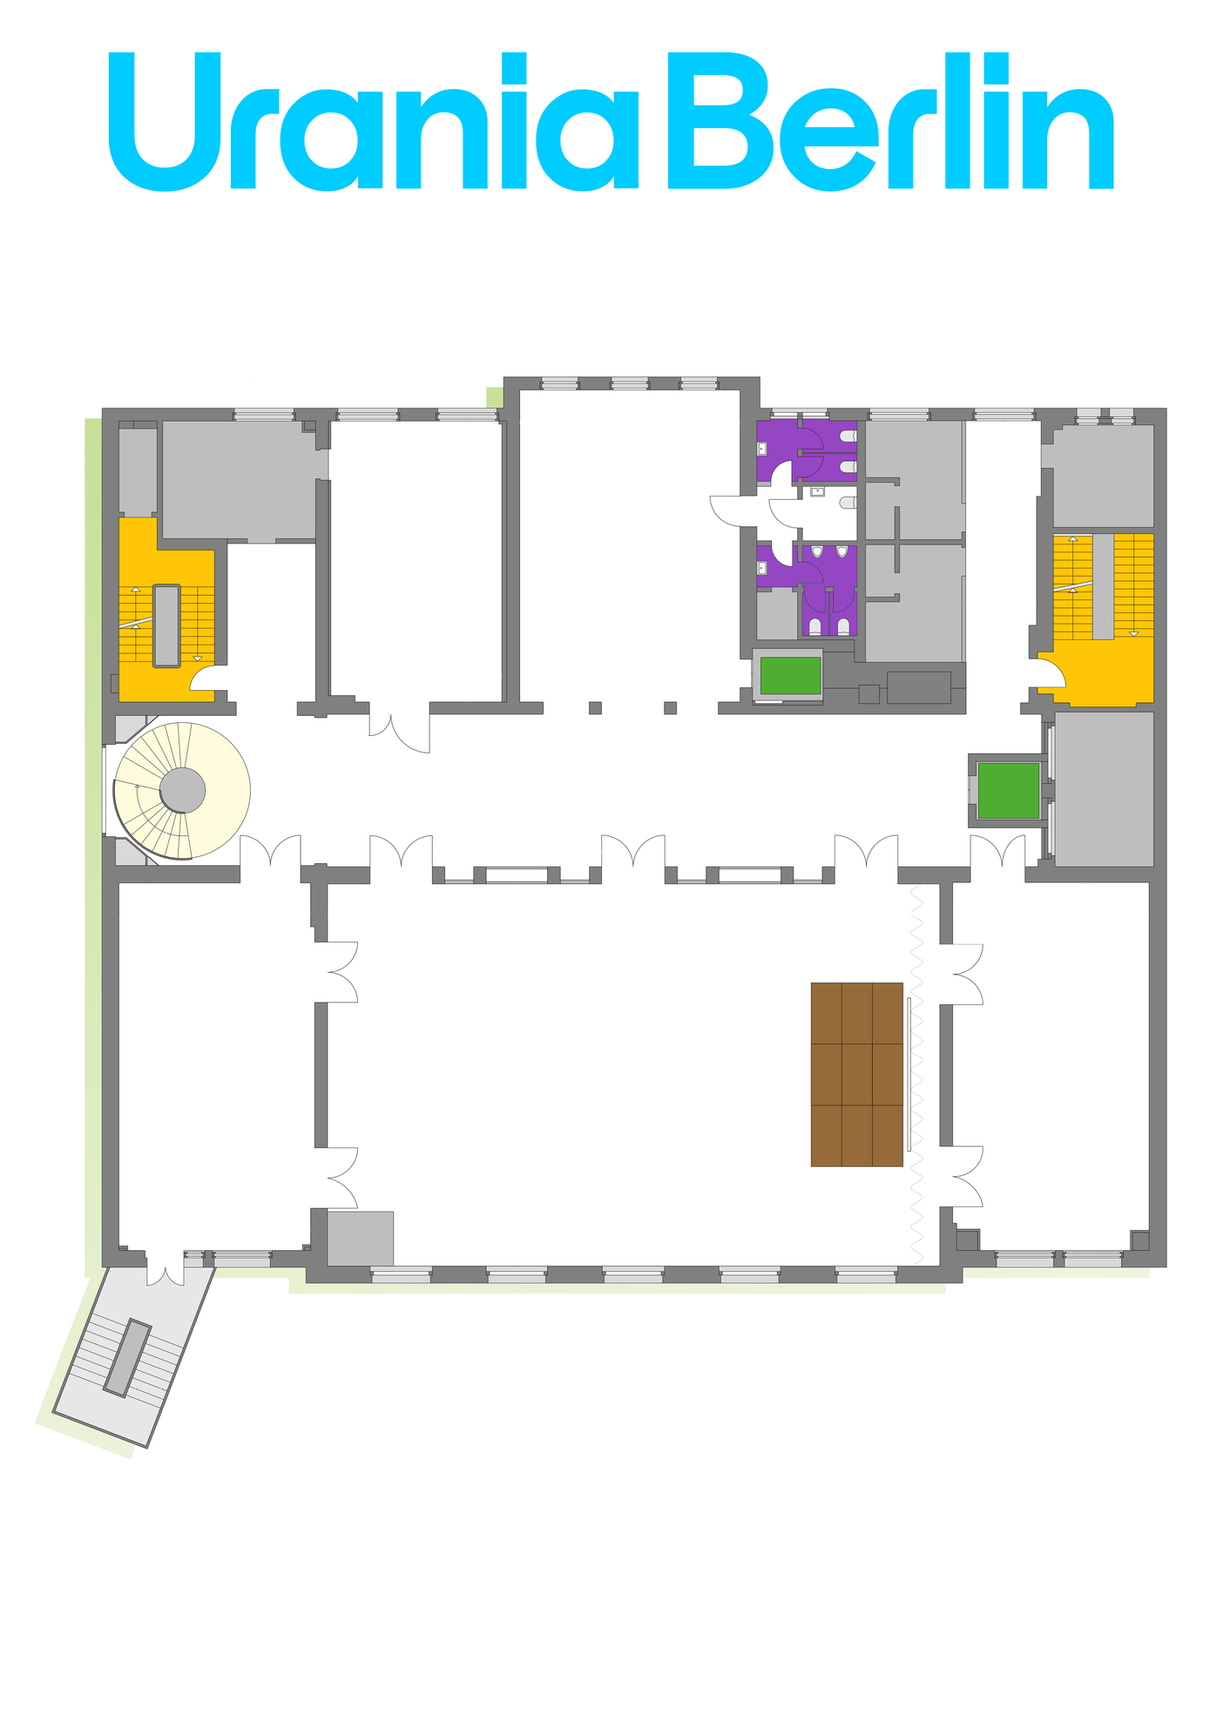
Urania Berlin
Second Floor
Spontaneous
Conversation
Area
Austen
Kids Room
Networking
1:1s
Spontaneous Conversation area
Austen
Kids Room
Point B2
Conversation Area
To floors 1 & 3
0, 1, 3
Point 3 - Conversation
Area
Second Floor Foyer
To floor 3
Darwin
Speaker Room
Edison
Meetups & Workshops
Newton
Office Hours
Darwin
Speaker Room
Edison
Workshops / Meet-ups
Newton
Office Hours
Point B3
Newton
Point B1
Edison
Meeting point
Elevators
Stairs
Gender-neutral bathrooms Stages

Slide 4
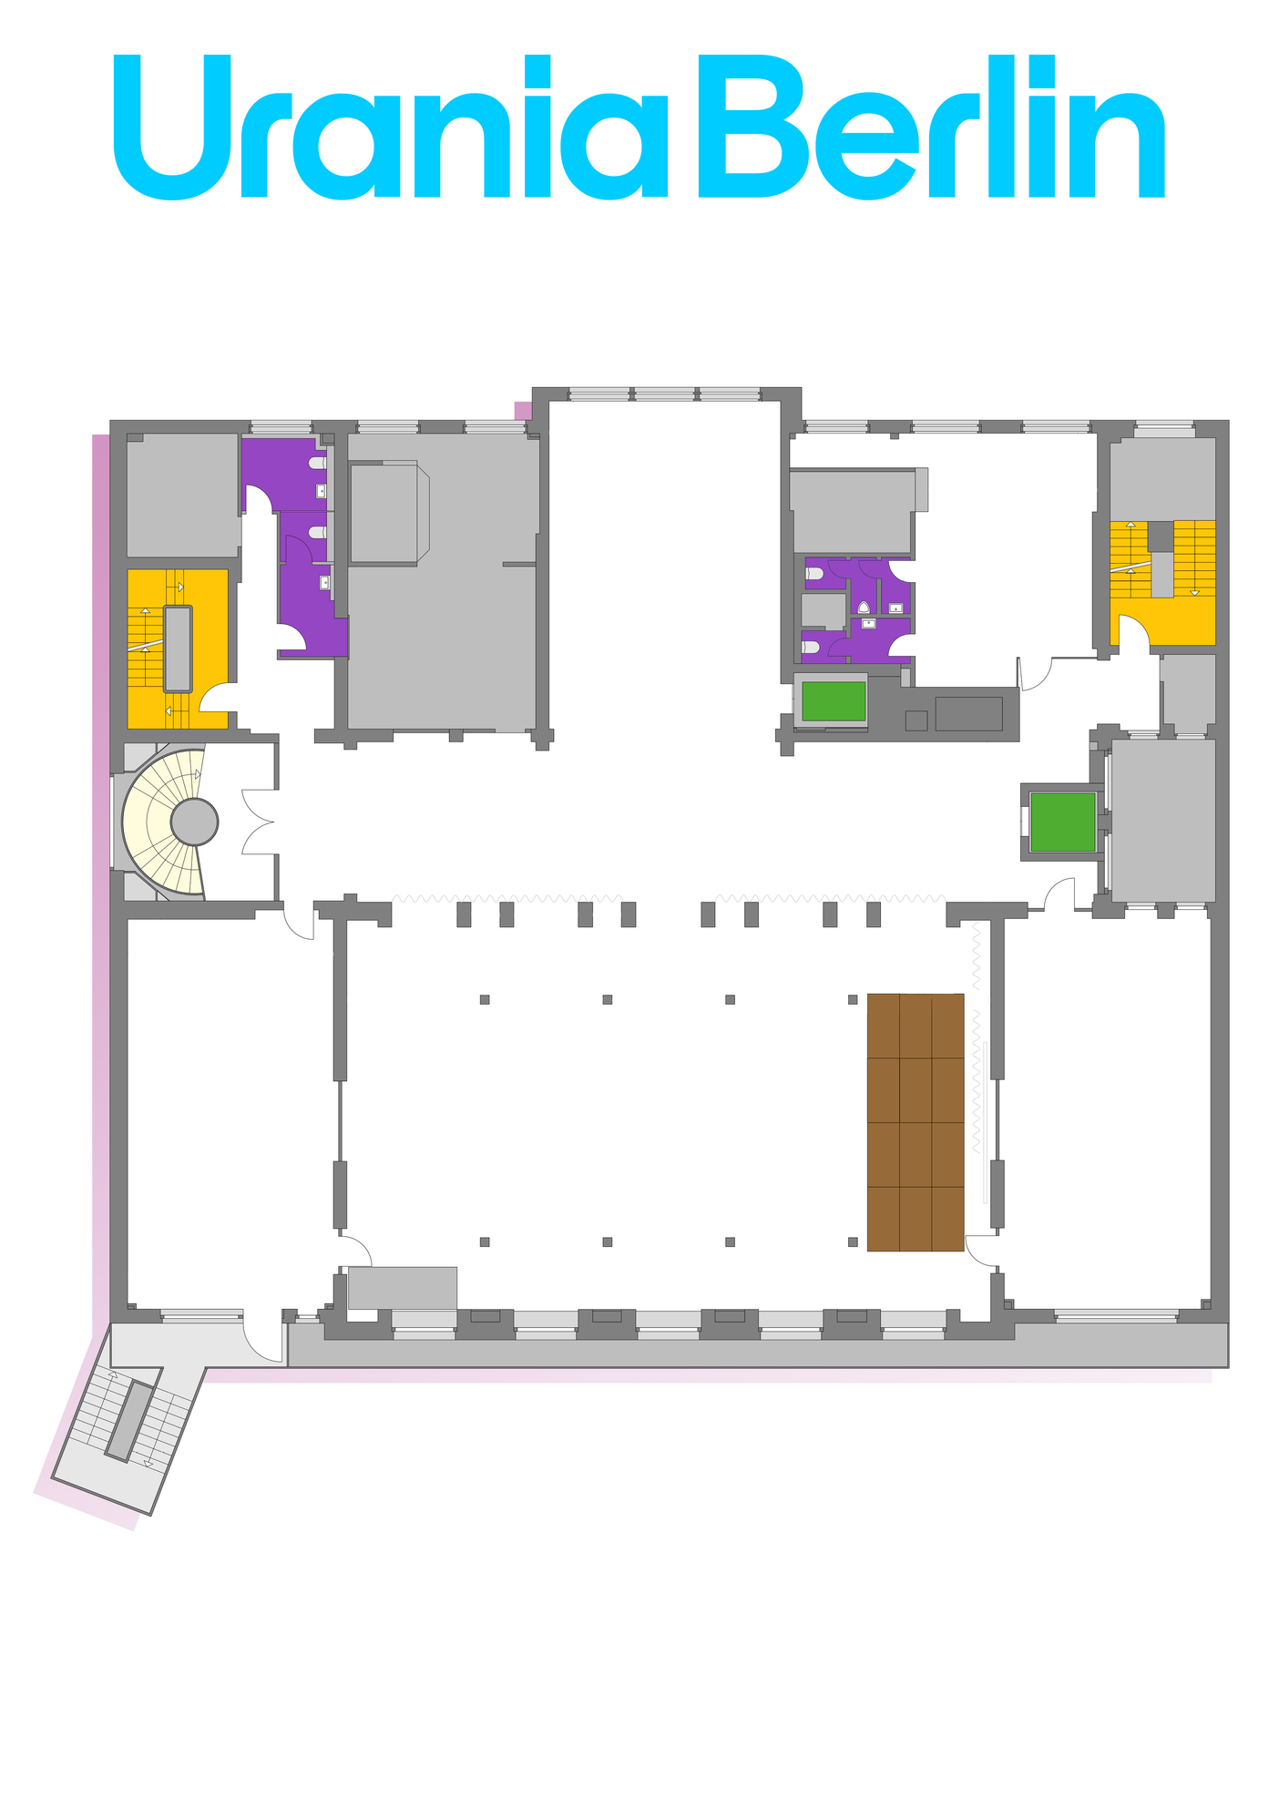
Urania Berlin
Third Floor
Catering
Silent working room
To floors 1 & 2
0, 1, 2
To floor
2
Third Floor Foyer
Point A1
Voltaire
Curie
Meet-Ups & Office Hours
Point A2
Voltaire
Voltaire
1:1s
Pasteur
1:1s
Point A4
Curie
Point A3
Pasteur
Meeting point
Elevators
Stairs
Gender-neutral bathrooms Stages

